Slide 1
Chapter 5
Image Enhancement in Spatial Domain

Slide 2
What is Image Enhancement?
Image enhancement is the process of adjusting digital images so that the results are more suitable for display or further image analysis.
For example, you can remove noise, sharpen, or brighten an image, making it easier to identify key features.

Slide 3
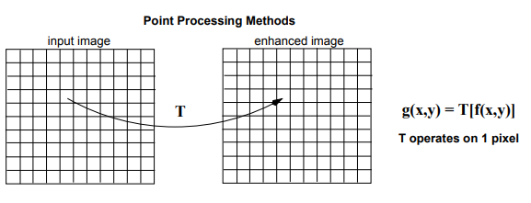
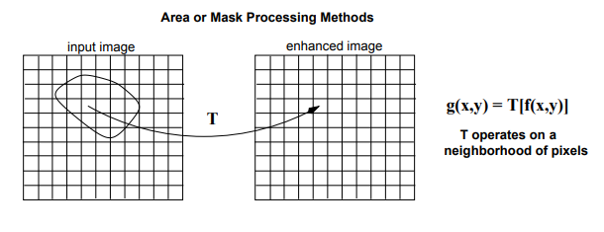
Spatial Domain Methods
Point Processing Transformation
Neighbourhood Processing Transformation

Slide 4
Point Processing Transformations/ Zero Memory Operations
Image Negative
Thresholding
Clipping
Intensity Level Slicing Without Background
Intensity Level Slicing With Background
Bit Plane Slicing
Contrast Stretching
Log Transformation

Slide 5
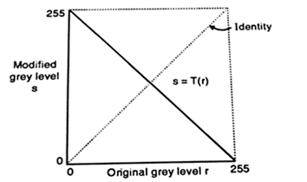
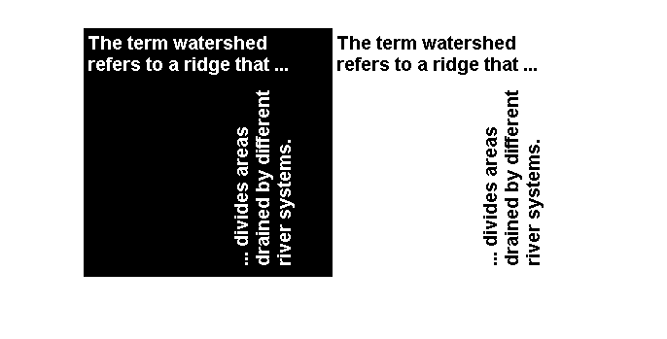
Point Processing Transformations/ Zero Memory Operations
Image Negative
Example Applications
- Useful in display of medical images
- Can be used in producing negative prints of an image
Hence when r=0,s=255
and when r=255,s=0
In general,
s=(L−1)−r

Slide 6
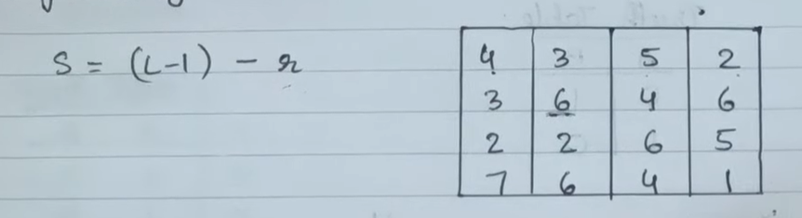
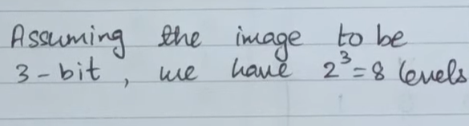
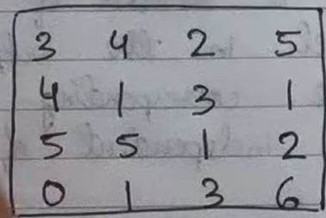
Point Processing Transformations/ Zero Memory Operations
Image Negative

Slide 7
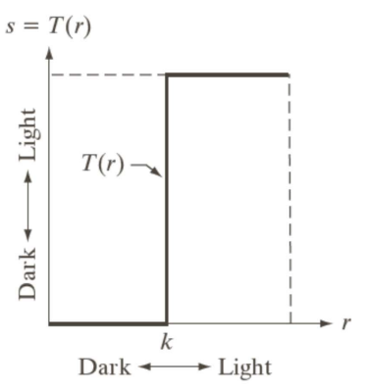
Point Processing Transformations/ Zero Memory Operations
Thresholding
Thresholding transformations are particularly useful for segmentation in which we want to isolate an object of interest from a background

Slide 8
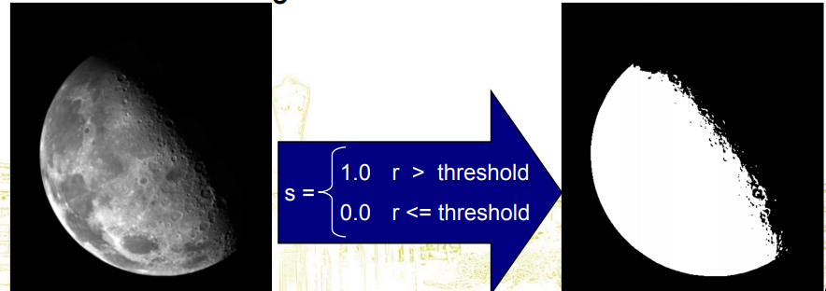
Point Processing Transformations/ Zero Memory Operations
Thresholding

Slide 9
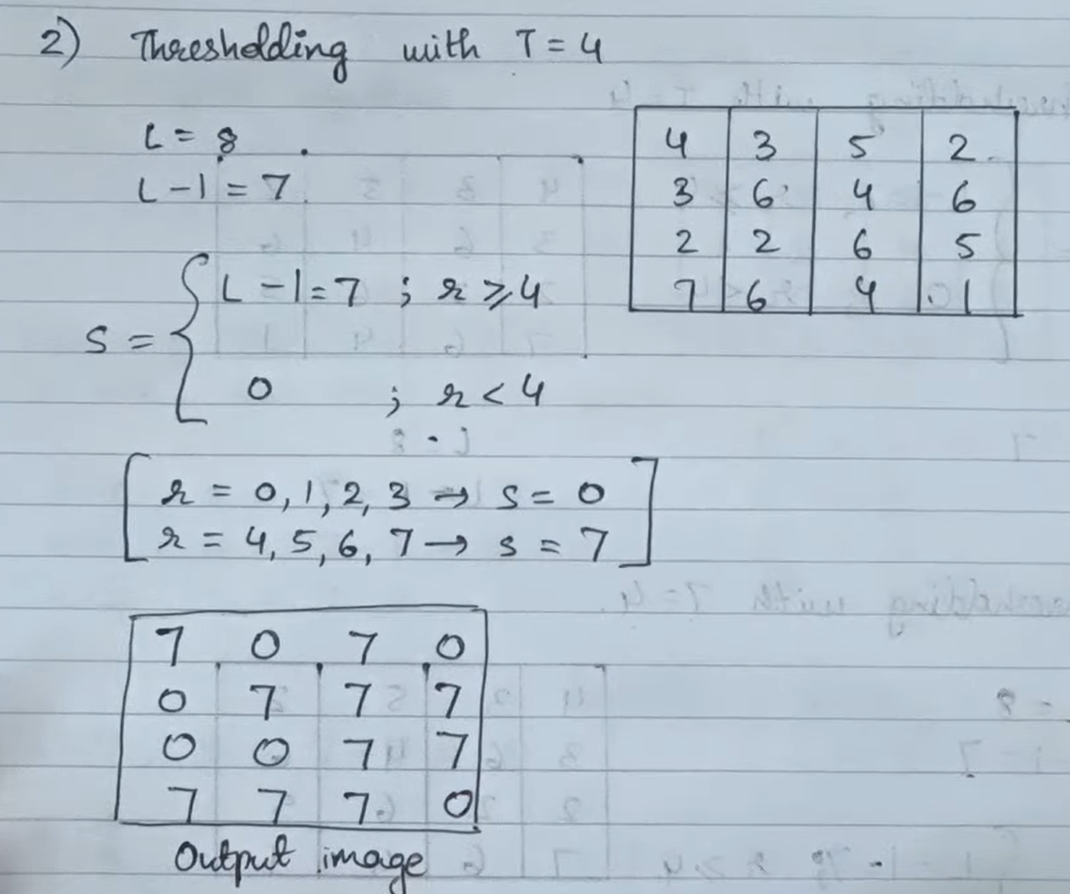
Point Processing Transformations/ Zero Memory Operations
Thresholding

Slide 10
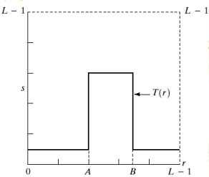
Point Processing Transformations/ Zero Memory Operations
Clipping ( Grey Level Slicing Without Background)
Useful in highlighting features in an image

Slide 11
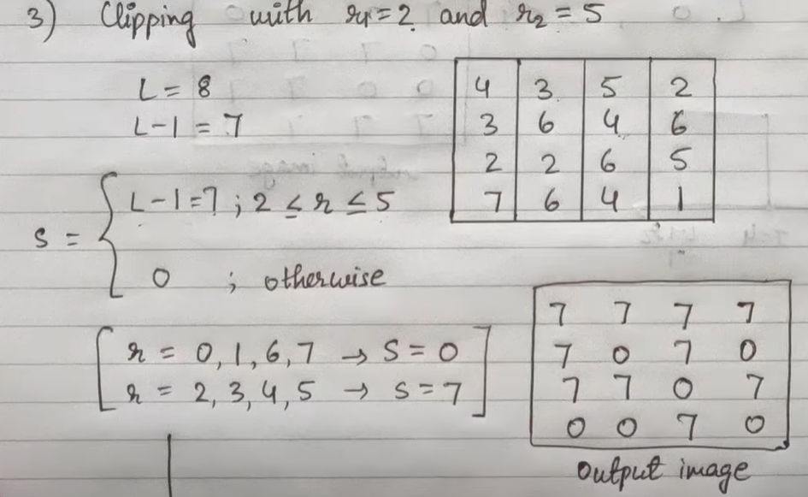
Point Processing Transformations/ Zero Memory Operations
Clipping ( Grey Level Slicing Without Background)

Slide 12
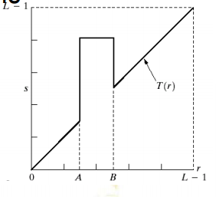
Point Processing Transformations/ Zero Memory Operations
Grey Level Slicing With Background
Useful in highlighting features in an image while retaining the background

Slide 13
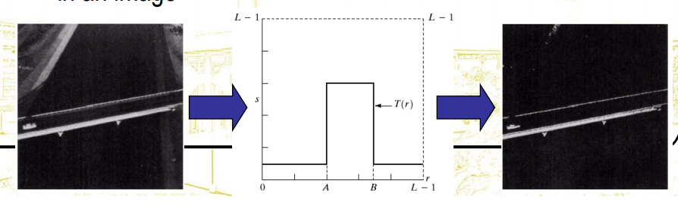
Point Processing Transformations/ Zero Memory Operations
Grey Level Slicing
Example

Slide 14
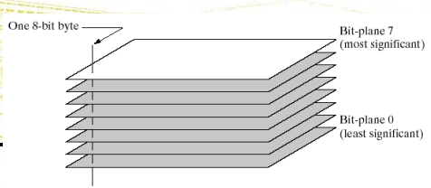
Point Processing Transformations/ Zero Memory Operations
Bit Plane Slicing
Often by isolating particular bits of the pixel values in an image we can highlight interesting aspects of that image
Higher-order bits usually contain most of the significant visual information
Lower-order bits contain subtle details

Slide 15
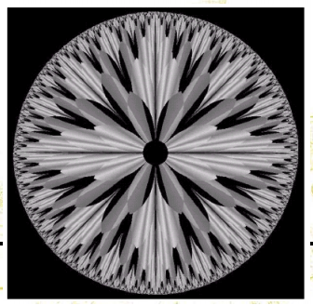
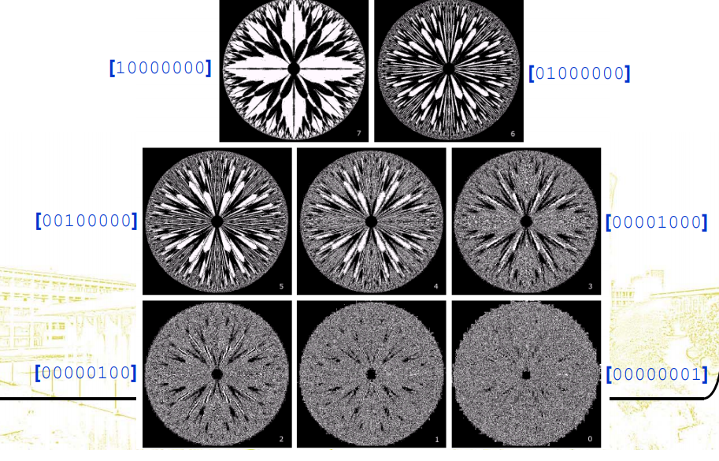
Point Processing Transformations/ Zero Memory Operations
Bit Plane Slicing
Example

Slide 16
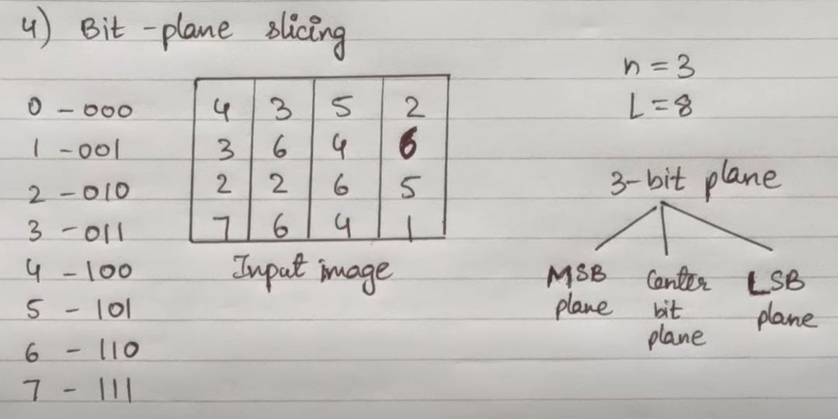
Point Processing Transformations/ Zero Memory Operations
Bit Plane Slicing
Example

Slide 17
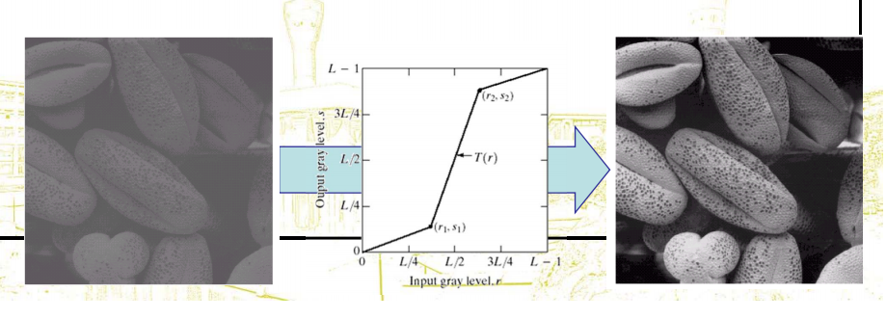
Point Processing Transformations/ Zero Memory Operations
Contrast Stretching ( Piecewise Linear Transformation)
Can be used to add contrast to a poor quality image

Slide 18
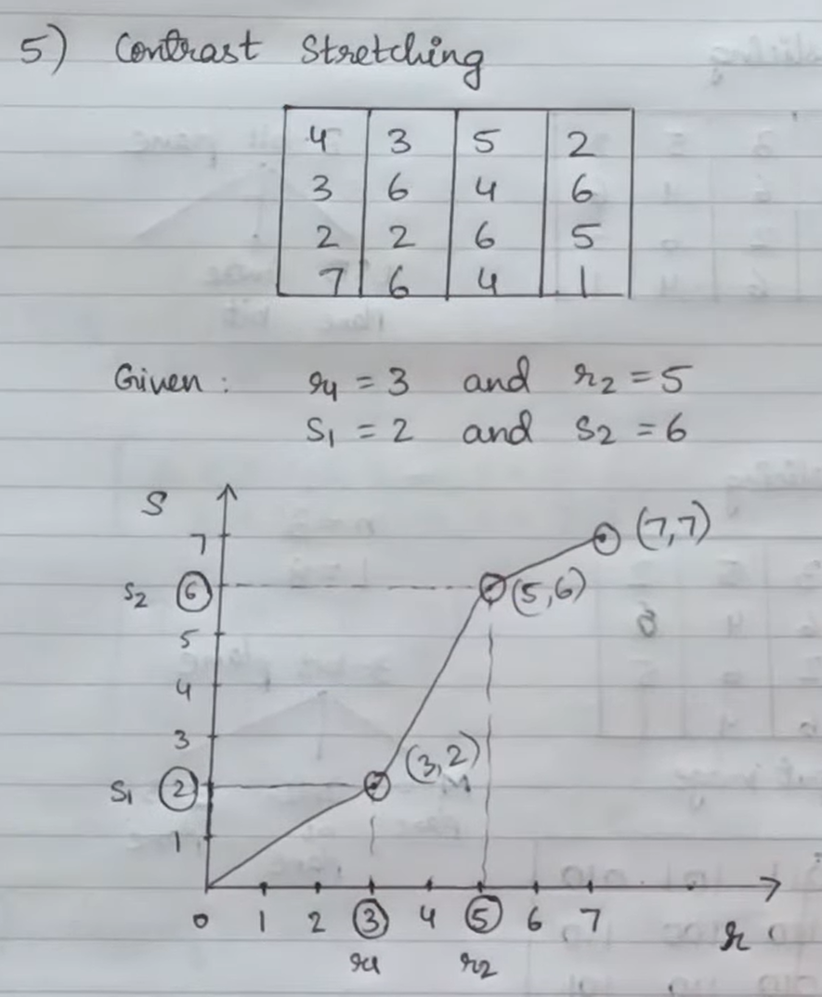
Point Processing Transformations/ Zero Memory Operations
Contrast Stretching ( Piecewise Linear Transformation)

Slide 19
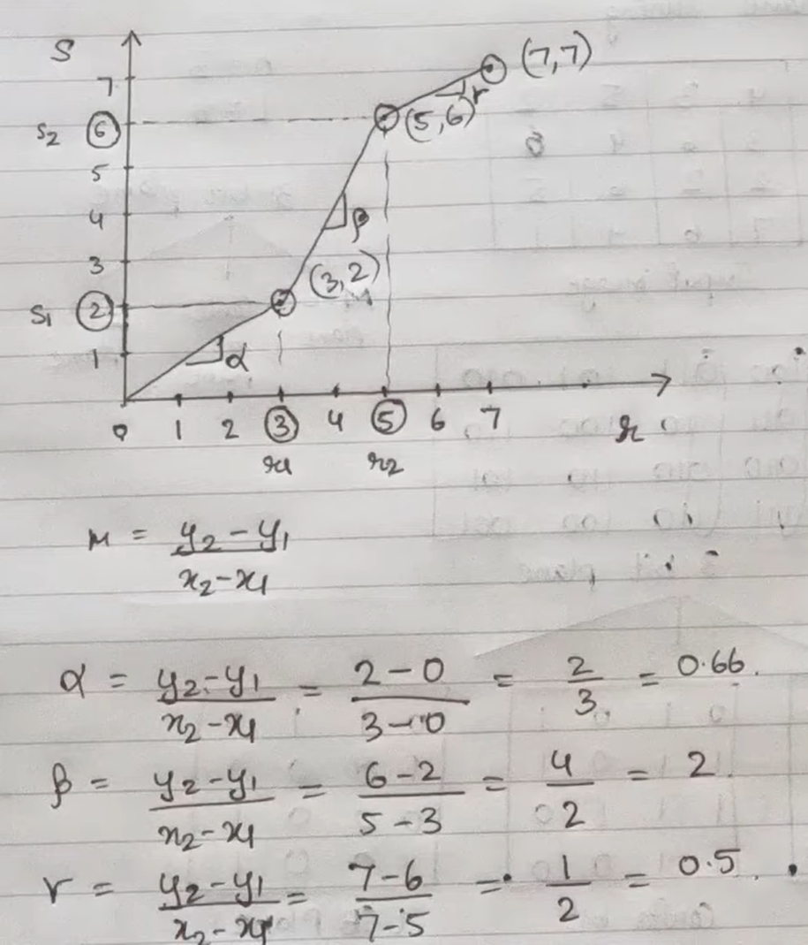
Point Processing Transformations/ Zero Memory Operations
Contrast Stretching ( Piecewise Linear Transformation)

Slide 20
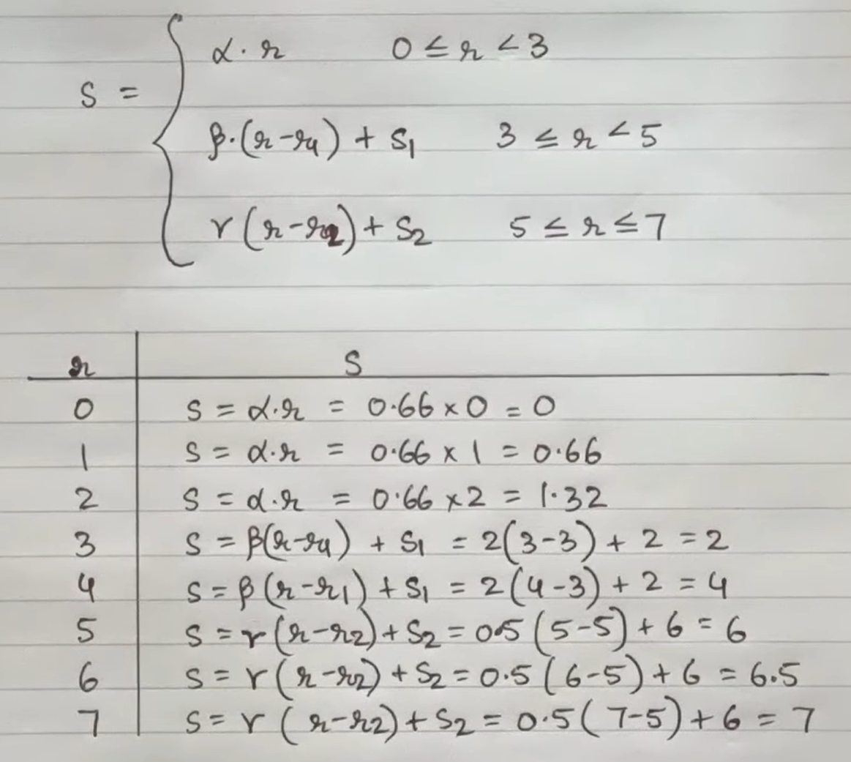
Point Processing Transformations/ Zero Memory Operations
Contrast Stretching ( Piecewise Linear Transformation)

Slide 21
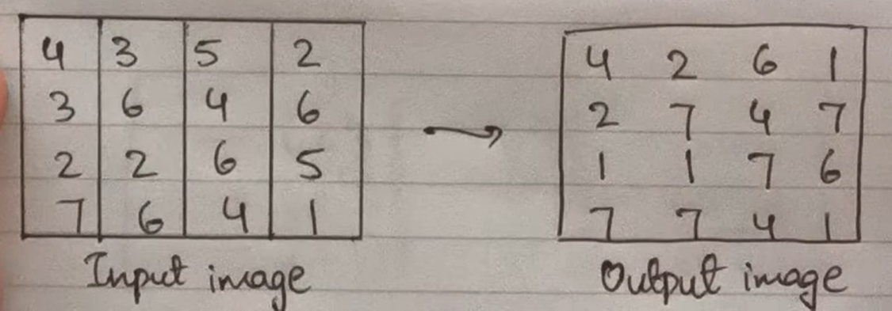
Point Processing Transformations/ Zero Memory Operations
Contrast Stretching ( Piecewise Linear Transformation)

Slide 22
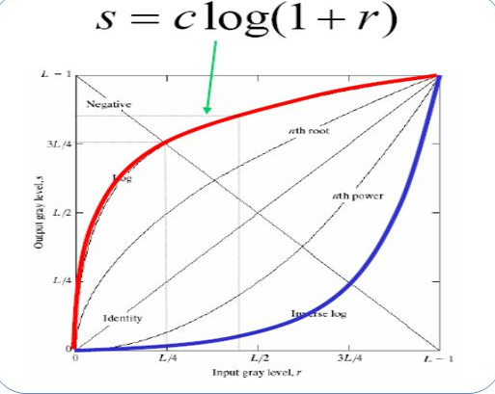
Point Processing Transformations/ Zero Memory Operations
Log Transformation( Dynamic Range Compression)
Log functions are particularly useful when the input grey level values may have an extremely large range of values
s = c log(r + 1)
During log transformation, the dark pixels in an image are expanded as compared to the higher pixel values. The higher pixel values are kind of compressed in log transformation. This result in following image enhancement

Slide 23
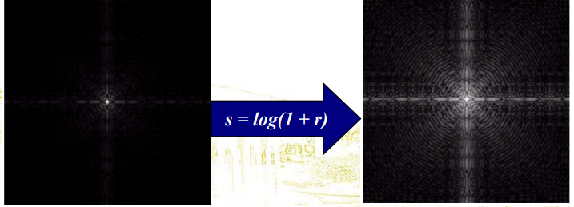
Point Processing Transformations/ Zero Memory Operations
Log Transformation( Dynamic Range Compression)
•In the following example the Fourier transform of an image is put through a log transform to reveal more detail

Slide 24
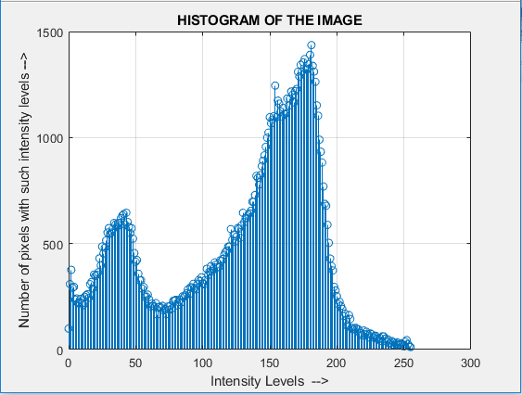
Histogram Processing
Histogram
A graph showing the number of pixels in an image at each different intensity value found in that image.

Slide 25
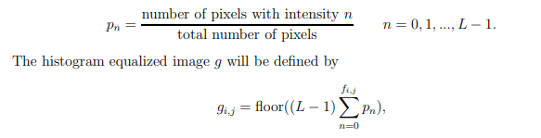
Histogram Equalization
Histogram equalization is a technique for adjusting image intensities to enhance contrast.
It tries to produce an output image that has a uniform histogram.
Let f be a given image having pixel intensities ranging from 0 to L − 1

Slide 26
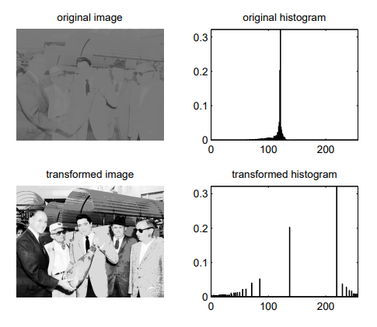
Histogram Equalization
Disadvantage of histogram equalization
This approach is good but for some cases, this does not work well. One such case is when we have skewed image histogram i.e. large concentration of pixels at either end of greyscale.

Slide 27
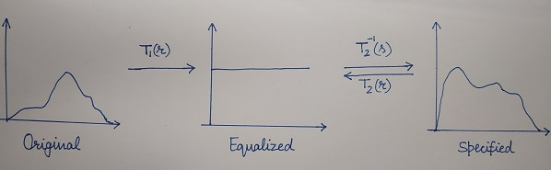
Histogram Specification ( Histogram Matching)
Histogram matching or histogram specification is the transformation of an image so that its histogram matches a specified histogram.
First equalize both original and specified histogram using the Histogram Equalization method.
Map equalized histogram to specified histogram

Slide 28
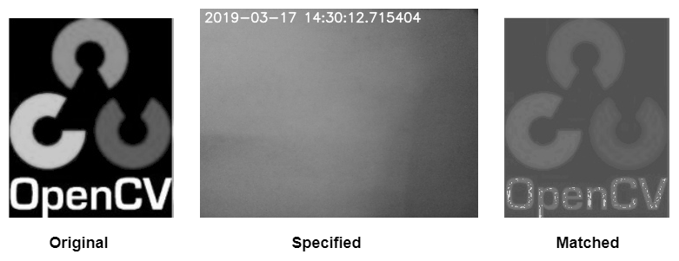
Histogram Specification ( Histogram Matching)
For Example
Suppose the pixel value 10 in the original image gets mapped to 20 in the equalized image. Then we will see what value in Specified image gets mapped to 20 in the equalized image and let’s say that this value is 28. So, we can say that 10 in the original image gets mapped to 28 in the specified image

Slide 29
Neighbourhood Processing
Spatial Filtering
Smoothening Filters
Sharpening Filters
Median Filters

Slide 30
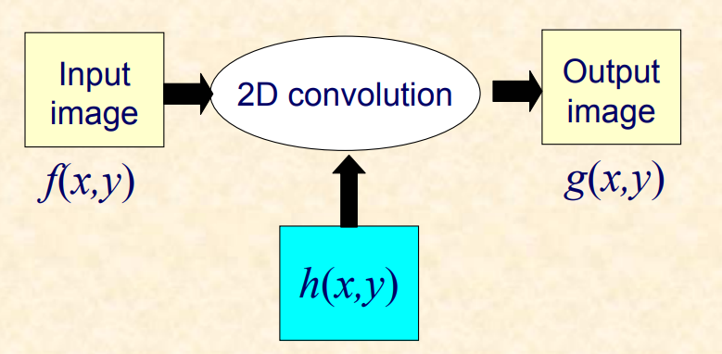
Image Filtering in Spatial Domain

Slide 31
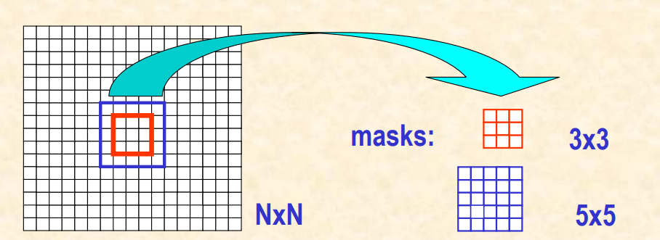
Image Filtering in Spatial Domain

Slide 32
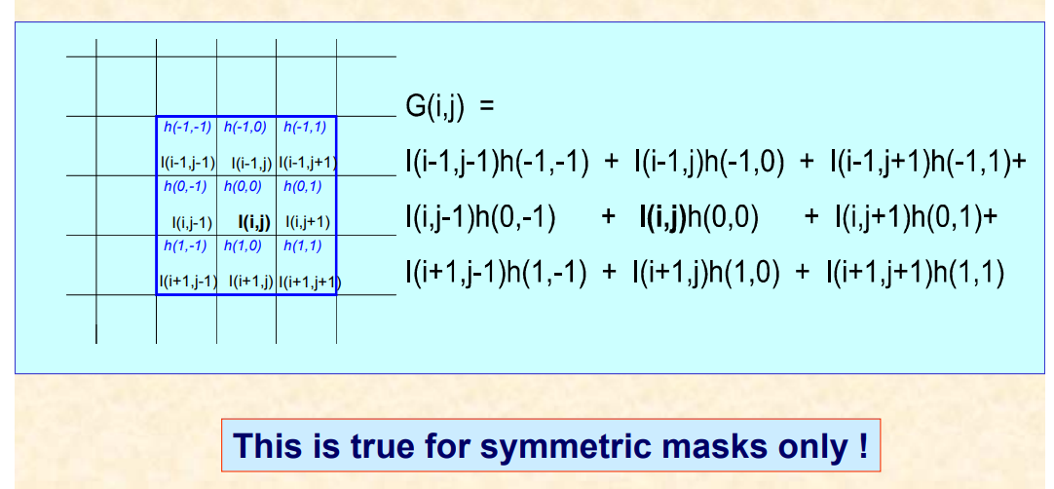
Image and Filter Mask Convolution

Slide 33
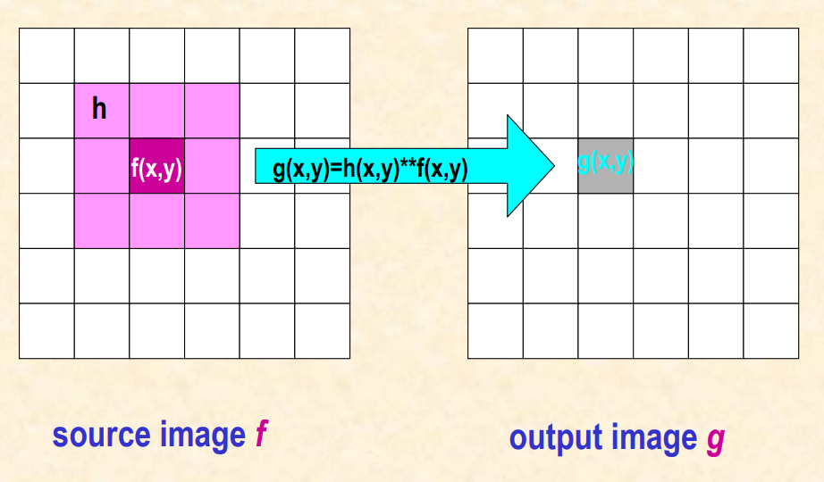
Computing the Filtered Image

Slide 34
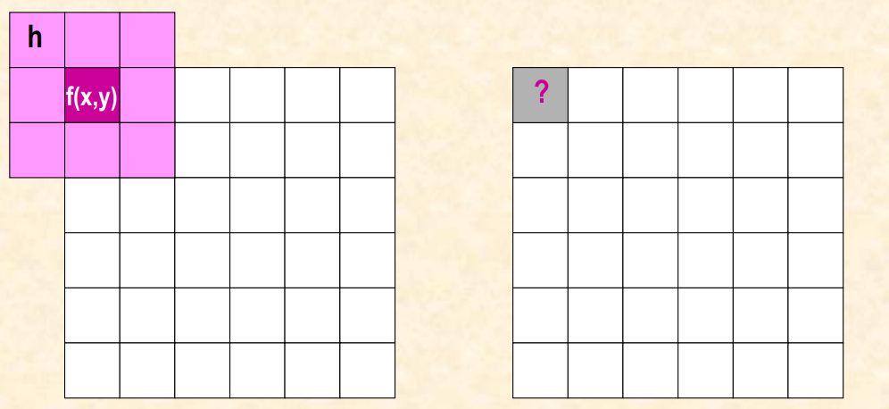
Boundary Effects

Slide 35
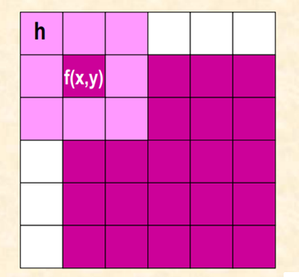
Boundary Effects- 3X3 Mask

Slide 36
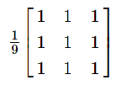
Neighbourhood Processing
Smoothening Filters
Low Pass Filters ( Averaging Filters)
Used to remove high spatial frequency noise from a digital image.
The low-pass filters usually employ moving window operator which affects one pixel of the image at a time, changing its value by some function of a local region (window) of pixels.
The idea is simply to replace each pixel value in an image with the mean (`average') value of its neighbours, including itself.
3x3 LPF Mask

Slide 37
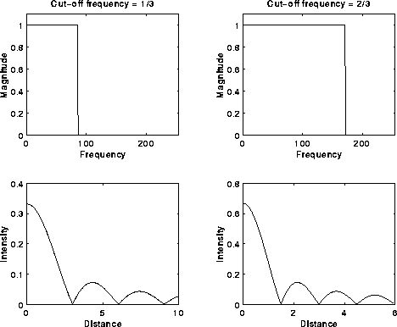
Neighbourhood Processing
Low Pass Filters ( Averaging Filters)

Slide 38
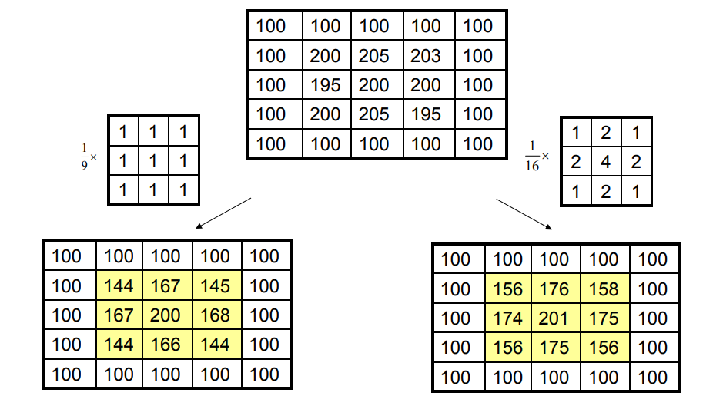
Neighbourhood Processing
Applying Low Pass Filters ( Averaging Filters)

Slide 39
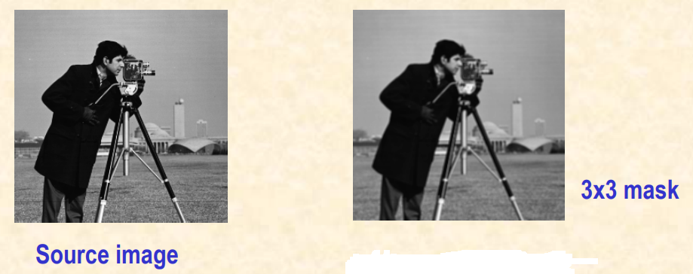
Neighbourhood Processing
Low Pass Filters ( Averaging Filters)
Example

Slide 40
Neighbourhood Processing
Smoothening Filters
Median Filters
Instead of simply replacing the pixel value with the mean of neighbouring pixel values, it replaces it with the median of those values.
The median is calculated by first sorting all the pixel values from the surrounding neighbourhood into numerical order and then replacing the pixel being considered with the middle pixel value.
Advantages of median filter over averaging filter
The median is a more robust average than the mean and so a single very unrepresentative pixel in a neighbourhood will not affect the median value significantly.
Since the median value must actually be the value of one of the pixels in the neighbourhood, the median filter does not create new unrealistic pixel values when the filter straddles an edge. For this reason the median filter is much better at preserving sharp edges than the mean filter.

Slide 41
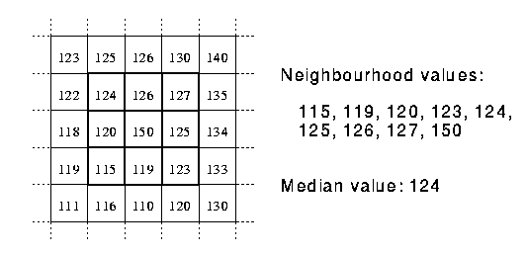
Neighbourhood Processing
Median Filters

Slide 42
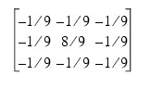
Neighbourhood Processing
Sharpening Filters
High Pass Filter
A high pass filter tends to retain the high frequency information within an image while reducing the low frequency information.
The kernel of the high pass filter is designed to increase the brightness of the centre pixel relative to neighbouring pixels.
The kernel array usually contains a single positive value at its centre, which is completely surrounded by negative values.
The following array is an example of a 3 by 3 kernel for a high pass filter:

Slide 43
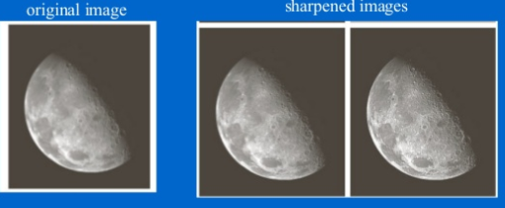
Neighbourhood Processing
Sharpening Filters
High Pass Filter

